Slide 1
International Line Iceberg Display
Product Owner Reference
Mr. Cline
US Coast Guard Research and Development Center
Revised 10/18/2018

Slide 2
Team Members
Owner – Mr. Cline
Advisor – Dr. Mraz
Subject Matter Expert – Dr. Kessler
Subject Matter Expert – Mr. Gold
2/c Christopher Rosselot
2/c Luke Arsenault
2/c Hayden Carter
2/c Maylis Yepez
2/c Thomas Hardy

Slide 3
Product Elevator Pitch Statement
L.I.D takes daily information transmitted from the NAIS (North American Ice Service), converts LAT/LONG position of iceberg risk boundaries into a usable format of contour lines which then will be sent out to mariners to be plotted on commercial navigation equipment.

Slide 4
Product Vision Board
Target Customer | Needs | Product | Value
Mr. Cline | Validation of output | The code to run the software | Continual development of software to support the missions of IIP
Public Mariners | Save time and feel safe when navigating by icebergs | Software compatible with AIS/Nav system | Keep local mariners safe, and substantial time saving
NAIS | Quick dissemination of information from NAIS | Software that’s ready to publish new data daily | Fewer errors with conversion of daily information

Slide 5
Customer Persona
Profile | Goals | Persona Name
ORCA at CG RnD Center | Demonstrate Practicality | Calvin
Mariners traversing the North Atlantic | Have program to keep them safe | Captain Hook
Organization of people disseminating information on icebergs | Have a software to invert text file into mappable data | Big Brother

Slide 6
Impact Mapping
Goal | Actor | Impact | Deliverable
Intaking daily risk contours, converting to AIS payload | Big Brother | Progress in an ongoing project and success in the subproject | Working Program
 | Calvin |  | Software with mappable data
 | Captain Hook | Automated delivery of information, allowing better situational awareness of iceberg risk area | Display on true navigation systems domestic and international
 | Capitaine Hook
 | CAPT Vann |  | Display on Portable Device (Laptop)
 | Iceberg Chasers |  | Display on internet
 | Risk Takers | Informed decisions made for risk taking | Density of icebergs within a specific region
 | Casual File Uploaders | Ability to use data in commercial systems (google earth) | File Conversion to kml
 | Climate Change Enthusiasts | Access to information to bolster research/arguments | Historical data, trends, moving graph, access from internet, display on navigation systems and portable devices
 | Polar Research Fleet

Slide 7
Activity Diagram
IIS
NAIS
LID
CAPT Hook
Capitaine Hook
Calvin
Research
Broadcast
Lat/Long
Daily Iceberg Bulletin
Parser
Bearing/
Distance
AIS msg payload format
Encap. Payload to AIS
Structure Data
Data
Bearing/Dist. Data
Receive
TV-32 Display
Validate
Lat/Long
TV-32 Display
Compare Bulletin
KML
Google
Time Series

Slide 8

SPRINT 1

Slide 9
Activity Diagram – Sprint 1
IIS
NAIS
LID
CAPT Hook
Capitaine Hook
Calvin
Research
Broadcast
Lat/Long
Daily Iceberg Bulletin
Parser
Bearing/
Distance
AIS msg payload format
Encap. Payload to AIS
Structure Data
Data
Bearing/Dist. Data
Receive
TV-32 Display
Validate
Lat/Long
TV-32 Display
Compare Bulletin
KML
Google
Google Earth Display
Time Series
Initial Sprint Efforts to demonstrate ingesting data and producing intermediate decimal data for Bearing/Distance calculations.

Slide 10
Sprint 1
Date: 30OCT19 Sprint: 1-2 Team: LID
 | Task | Priority | Est Time | Assigned | Actual Time | Percent Complete
1 | Create our own Bulletin | 5 | 1 | Maylis Yepez | 1 | 100
2 | Use Google Earth to Load A KML file | 7 | 2 | Hayden Carter | 2 | 100
3 | Bulletin Acquisition | 7 | 3 | Christopher Rosselot | 3 | 100
4 | Data Parser | 10 | 4 | Tom Hardy | 6 | 100
5 | KML File Creation | 8 | 4 | Hayden Carter | 5 | 100
6 | Distance/Bearing Research | 6 | 3 | Maylis Yepez | 3 | 80
7 | GitHub Operational | 9 | 2 | Chris Rosselot | 2 | 100
8 | Tv-32 Research | 7 | 3 | Luke Arsenault | 3 | 100
9 | Integration between 3 classes | 10 | 2 | Tom Hardy, Chris Rosselot | 2 | 100
10 | Backup KML File | 4 | 2 | Luke Arsenault | 3 | 100
Tasks performed to provide Google Earth representation of Iceberg Risk limits.

Slide 11
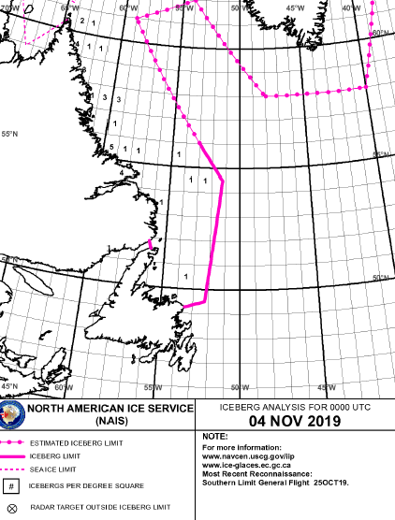
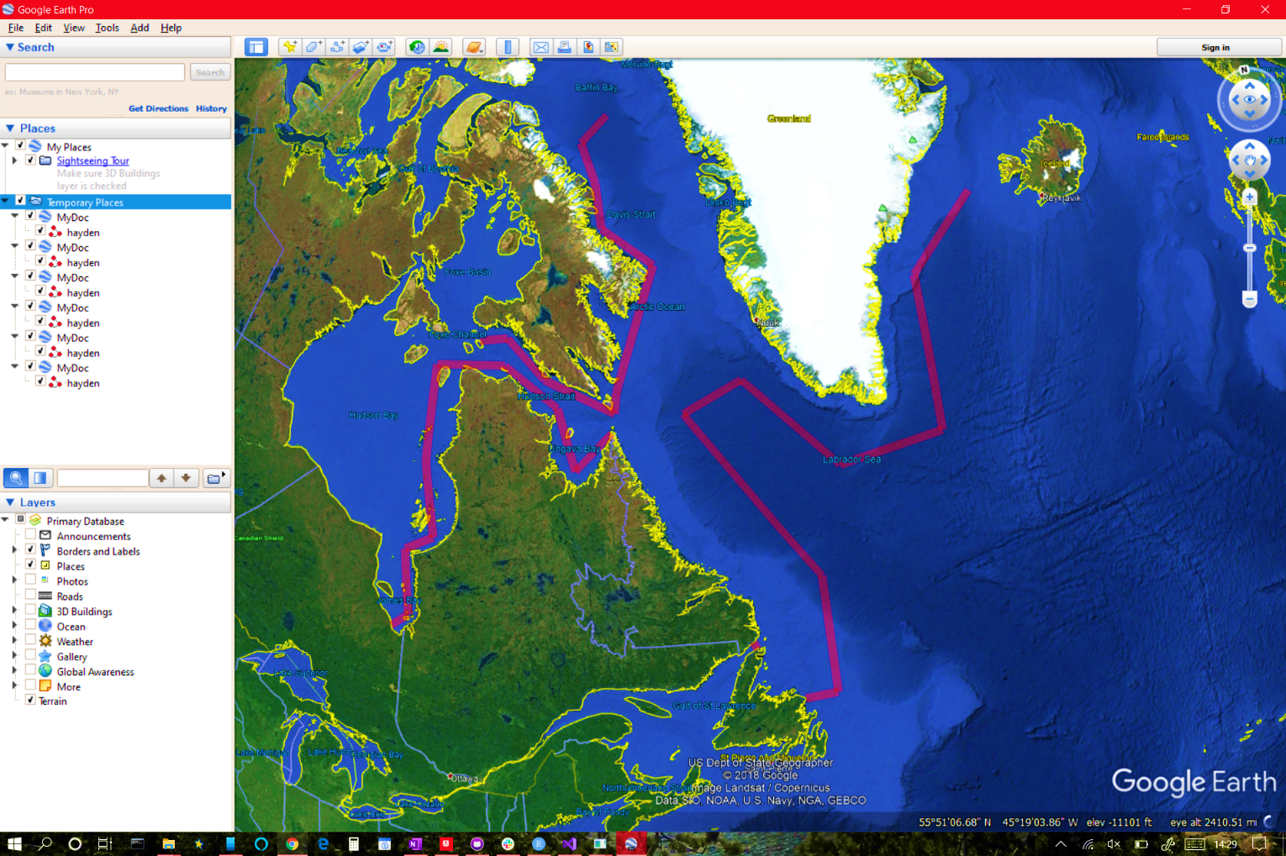
Sprint 1
Bulletin Image of NAIS website
Transformation to Google Earth
Visual Validation of transformation of coordinates to Google Earth KLM.
Notes:
Demonstration of line segment generation. Custom dashed line segments are to be added later.

Slide 12
Sprint 1
<?xml version="1.0" encoding="utf-8"?>
<kml xmlns="http://www.opengis.net/kml/2.2">
<Document id="null">
<name>MyDoc</name>
<open>true</open>
<Style id="thisusedtobelongname">
<LineStyle>
<color>501400fa</color>
<width>10</width>
</LineStyle>
<PolyStyle>
<color>501400fa</color>
</PolyStyle>
</Style>
<Placemark>
<name>hayden</name>
<visibility>false</visibility>
<styleUrl>#thisusedtobelongname</styleUrl>
<LineString>
<extrude>true</extrude>
<tessellate>true</tessellate>
<altitudeMode>clampToGround</altitudeMode>
<coordinates>-53.5,49.25
-51.5,49.25
-51,54
-53,56</coordinates>
</LineString>
</Placemark>
</Document>
</kml>
LATEST ICEBERG BULLETIN
1. NORTH AMERICAN ICE SERVICE (NAIS)
ICEBERG BULLETIN 050001Z NOV.
2. ICEBERG LIMIT ALONG TRACKLINE JOINING
49-15N 053-30W, 49-15N 051-30W,
54-00N 051-00W, 56-00N 053-00W.
3. ESTIMATED ICEBERG LIMIT ALONG
TRACKLINE JOINING
56-00N 053-00W, 61-00N 059-00W,
62-00N 054-00W, 58-00N 048-00W,
58-00N 040-00W, 64-00N 037-00W,
66-00N 028-00W.
4. WESTERN ICEBERG LIMIT ALONG TRACKLINE
JOINING
51-52N 056-05W, 51-34N 055-55W.
5. SEA ICE LIMIT ALONG TRACKLINES
JOINING:
A. 63-40N 077-00W, 63-55N 074-25W,
62-25N 070-35W, 61-10N 064-30W,
62-00N 064-20W.
B. 60-25N 064-45W, 58-55N 067-35W,
61-20N 069-15W, 62-50N 074-15W,
62-25N 080-35W, 58-30N 079-45W,
55-35N 078-10W, 54-50N 080-15W,
52-10N 079-20W, 51-30N 080-30W.
C. 62-00N 064-20W, 66-55N 060-40W,
68-30N 066-05W, 70-25N 067-10W,
72-10N 069-35W, 73-25N 066-25W.
…
9. CANCEL THIS MSG 060001Z NOV 19.
49.25,-53.5 49.25,-51.5 54,-51 56,-53 56,-53 61,-59 62,-54 58,-48 58,-40 64,-37 66,-28 51.866666,-56.083333 51.566666,-55.916666 63.666666,-77 63.916666,-74.416666 62.416666,-70.583333 61.166666,-64.5 62,-64.333333 60.416666,-64.75 58.916666,-67.583333 61.333333,-69.25 62.833333,-74.25 62.416666,-80.583333 58.5,-79.75 55.583333,-78.166666 54.833333,-80.25 52.166666,-79.333333 51.5,-80.5 62,-64.333333 66.916666,-60.666666 68.5,-66.083333 70.416666,-67.166666 72.166666,-69.583333 73.416666,-66.416666
Google Earth KML Line Segment Representation
Original Iceberg Data
Lat – Long format
Transform to Decimal Coordinates

Slide 13
SPRINT 2

Slide 14
Sprint 2
 | Task | Priority | Est Time | Assigned | Actual Time | Percent Complete
1 | GUI Creation / Integration | 7 | 4 | Tom / Chris / Hayden | 6/2/3 | 100
2 | Improved KML File Creation | 8 | 3 | Hayden / Tom | 5/3 | 100
3 | Distance and Bearing Calculations | 7 | 3 | Maylis | 3 | 100
4 | Man TV-32 File Creation | 5 | 2 | Luke | 5 | 100
5 | Improved File Output | 9 | 3 | Tom / Chris | 2/2 | 100
6 | GitHub Organization | 2 | 1 | Hayden/ Chris | 1/2 | 100
7 | PowerPoint | 10 | 2 | Chris/Tom/Hayden/Luke/Maylis | 2 | 100
8 | Timestamp | 4 | 2 | Tom/Hayden | 1/1 | 100
9 | Burndown Chart | 9 | 4 | Hayden | 1 | 60

Slide 15
Activity Diagram – Sprint 2
IIS
NAIS
LID
CAPT Hook
Capitaine Hook
Calvin
Research
Broadcast
Lat/Long
Daily Iceberg Bulletin
Parser
Bearing/
Distance
AIS msg payload format
Encap. Payload to AIS
Structure Data
Data
Bearing/Dist. Data
Receive
TV-32 Display
Validate
Lat/Long
TV-32 Display
Compare Bulletin
KML
Google
Google Earth Display
Time Series
GUI the Program and Improve Current Data
Continuing Research and Development on AIS/TV-32

Slide 16
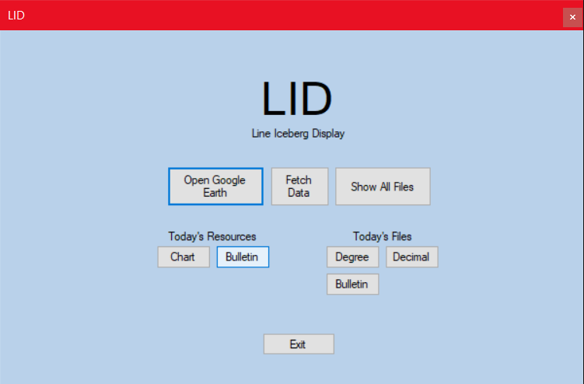
Sprint 2 - GUI
GUI for LID
Compare files to the resources released by the IIP
Open Google Earth Pro if you have it installed with the KML file produced
Open the directory containing all produced files to access any previous day
Examples of output on next slide

Slide 17
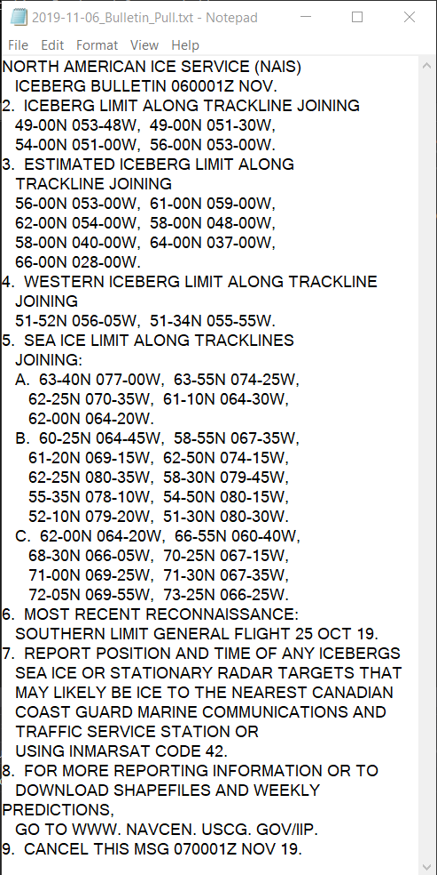
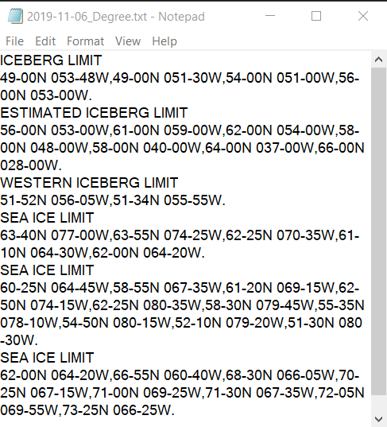
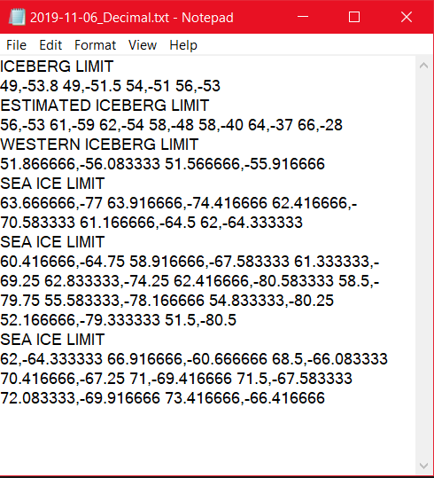
GUI Output
In the "Today's Files" section you can easily open and view the text files generated by the program
Each coordinate set is headed by the line type as set by the bulletin

Slide 18
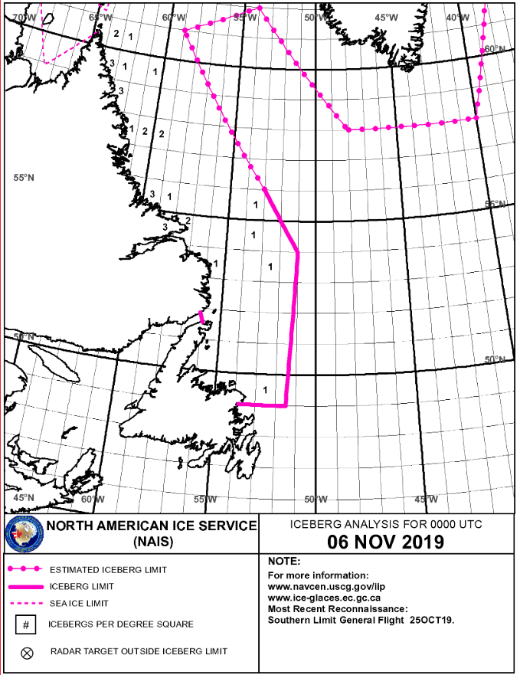
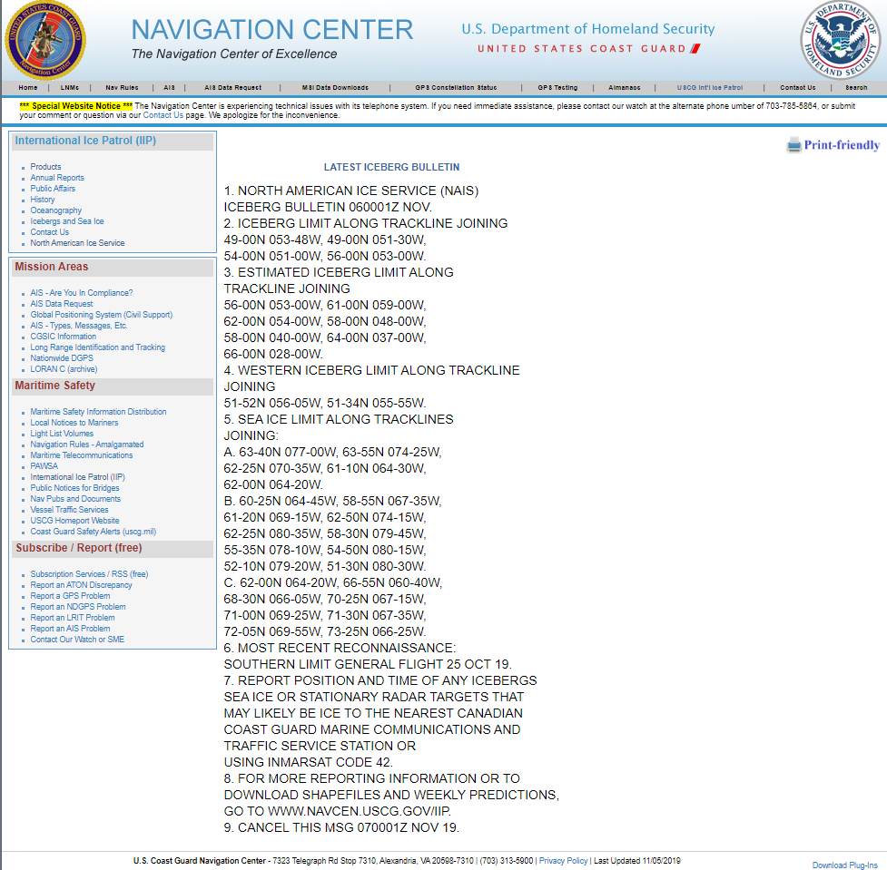
Sprint 2 – GUI Output – Today's Resources
Open's a link to the NAIS website
Current Chart
Current Bulletin
Allows for comparison with the Google Earth File or generated text files

Slide 19
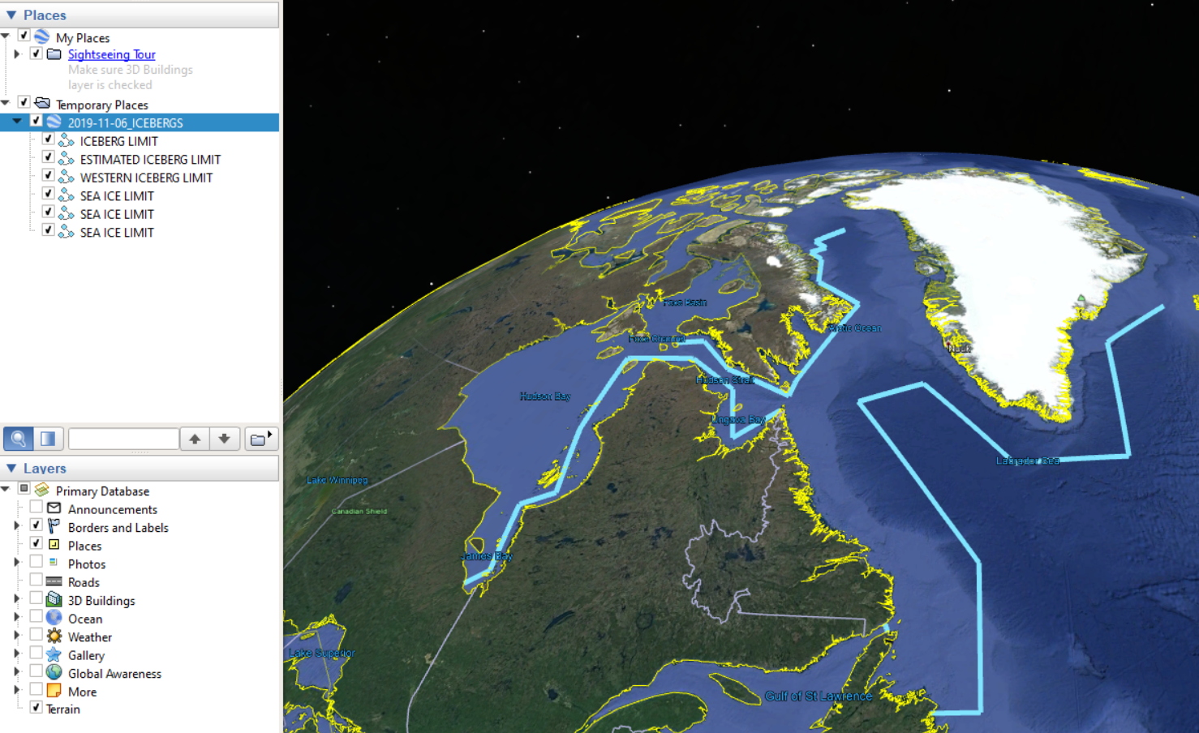
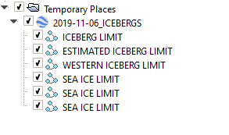
Google Earth
Display of generated KML file in google earth
Each line is named by the type of its section in the bulletin
More data is shown than in the released chart
If Google Earth Pro is not installed the button does nothing (no errors produced)
Released Chart for the same day

Slide 20
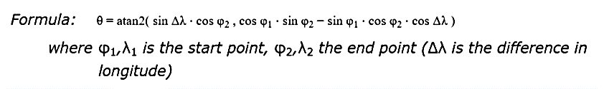
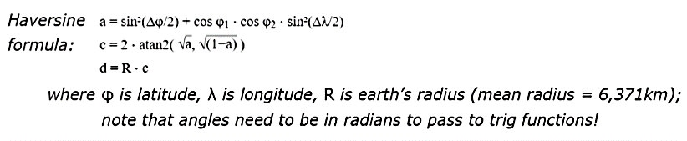
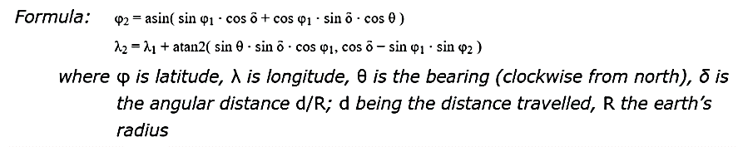
Sprint 2 - Bearing Calculation
Haversine Formula
Will calculate the great circle distance between two points – the shortest distance of the earth's surface.
- requires the coordinates be converted from degrees to radians
- output will be kilometers unless otherwise specified
Forward Azimuth & Destination Point
Forward Azimuth formula calculates the initial bearing of a straight line between two points on a great circle arc.
The destination point formula will calculate the final set of coordinates upon traveling along a great circle arc.
The program will output an average of the bearings, if not initial considering the line segments are small enough in length to neglect the final bearing.
Notes:
https://www.movable-type.co.uk/scripts/latlong.html

Slide 21
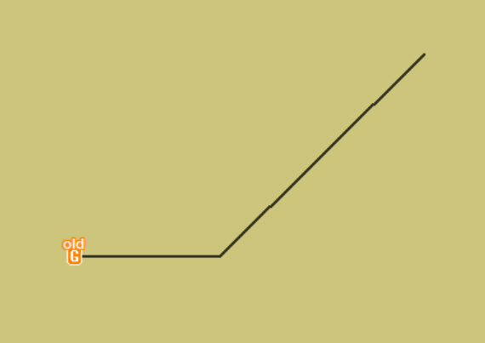
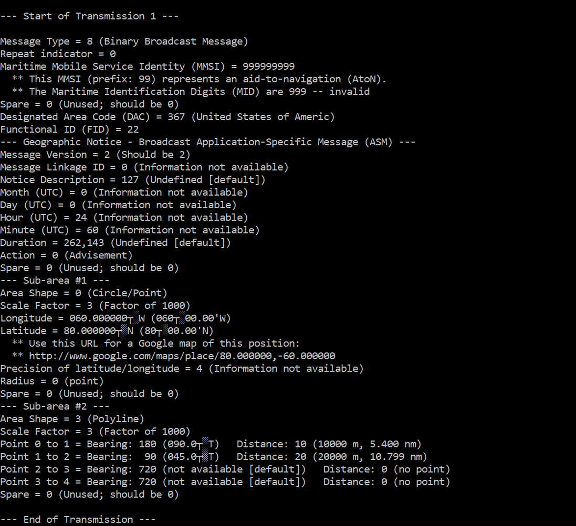
TV32 Type 8 Message
Create a Type 8 AIS message that will display a line on TV32
Using Dr. Kessler's programs
!AIVDM,1,1,2,A,B3uM9w000H>FuJ82PT5lKwn5oP06,0*2E,1572333720
!AIVDM,1,1,,A,8>qc9wiKmPP0wP37Wwwp7fmGP2o6h0P00000NFP2QJ0aJ00;@000,0*5E,1563885887,1563885887,1572333720
Notes:
How do we figure out what our timestamps should be?
How do we make the line stay up on TV32 while running thing playback?
How do we fix the playback so it displays the actual date that is included in the type 8 message?

Slide 22
SPRINT 3

